Slide 1

The Sunset Coverfew Alert SCA
Thevenot Gaspard & Angebaud Grégoire

Slide 2
Summary
Our ideas
Material & Software
How it works
Code & Results
Issues
Demo

Slide 3

Our Ideas
A new coverfew
An easier way to control
How to beat this system

Slide 4
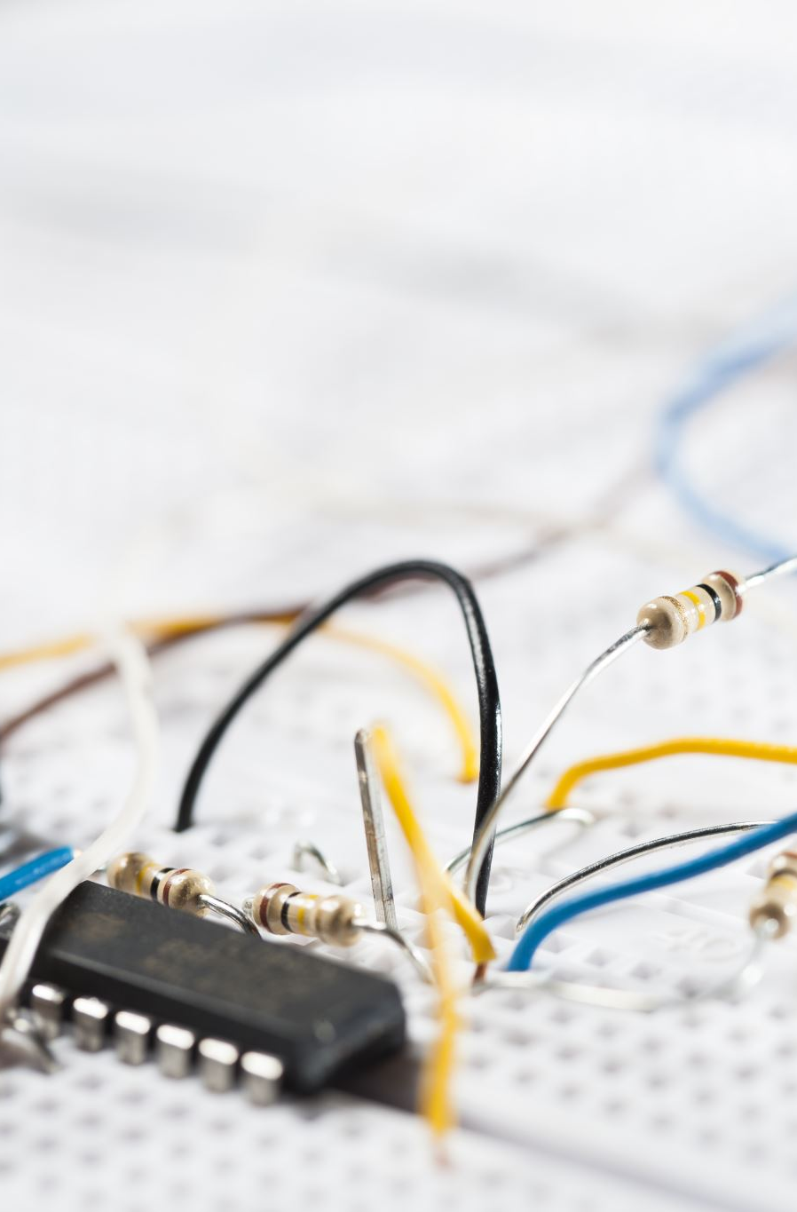
Material & Software
Esp 32
Photo resistance
Resistance
wires
Arduino IDE
ThingSpeak

Slide 5
The way it’s working
Collect the data
Send them to ThingSpeak
Create an algorithm
Send an alert

Slide 6
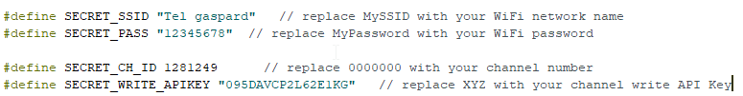
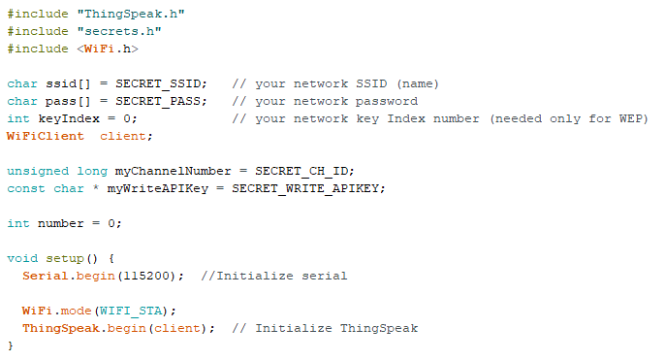
code

Slide 7
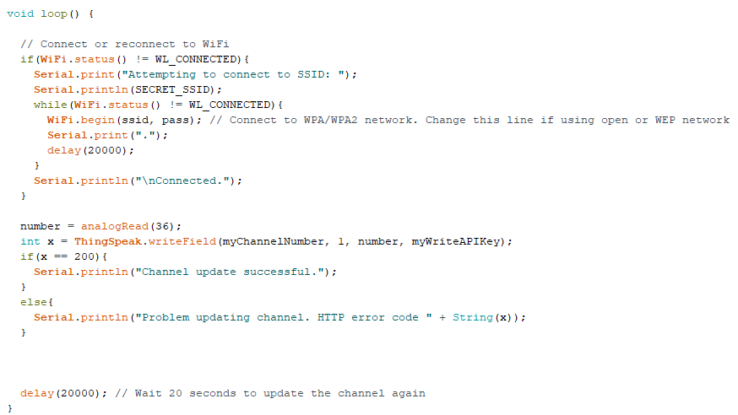
code

Slide 8
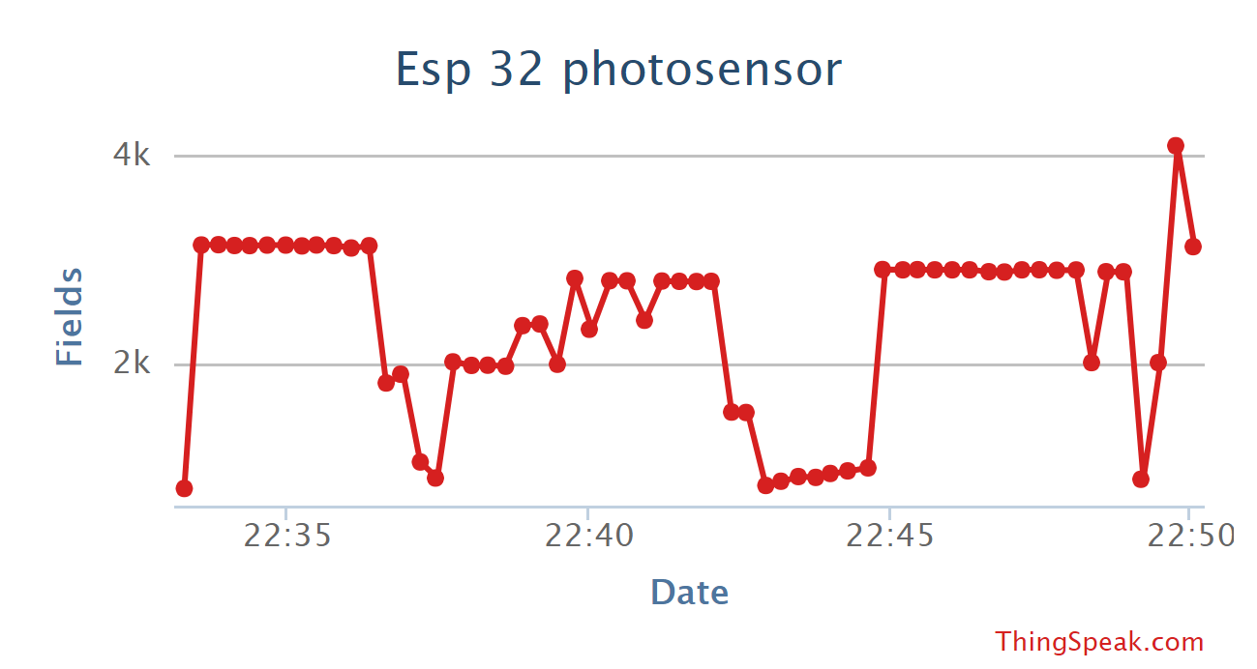
results

Slide 9
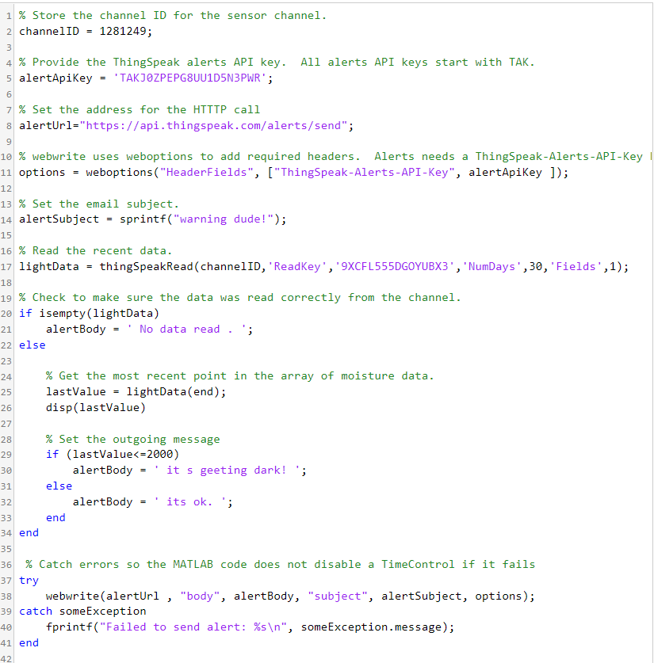
Code (ThingSpeak)

Slide 10
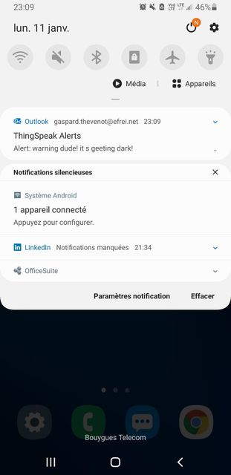
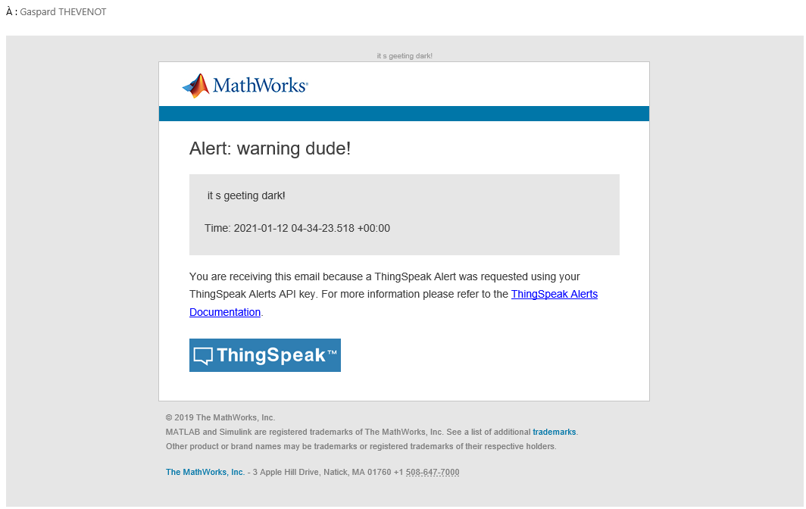
Results

Slide 11
Issues during conception

Slide 12
Demo

